Slide 1

Lecture 3
Sep 26, 2017
Jeonghyun Ko
Department of Chemical and Biomolecular Engineering
University of Notre Dame

Slide 2
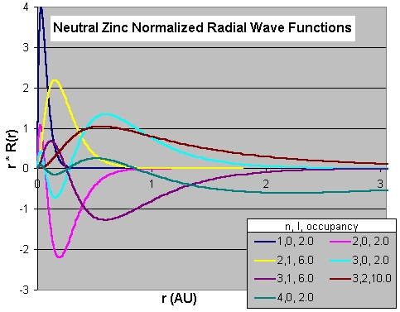
Numerical implementation
Herman - Skillman Program (1963)
One of the simplest Self-Consistent Field computational codes for determining wavefunctions and the associated potentials.
Main assumptions
Use only a single determinantal term
Replace the Hartree-Fock exchange potential terms with an average exchange potential (X_{alpha}) taken from the theory of a free-electron gas.

Slide 3
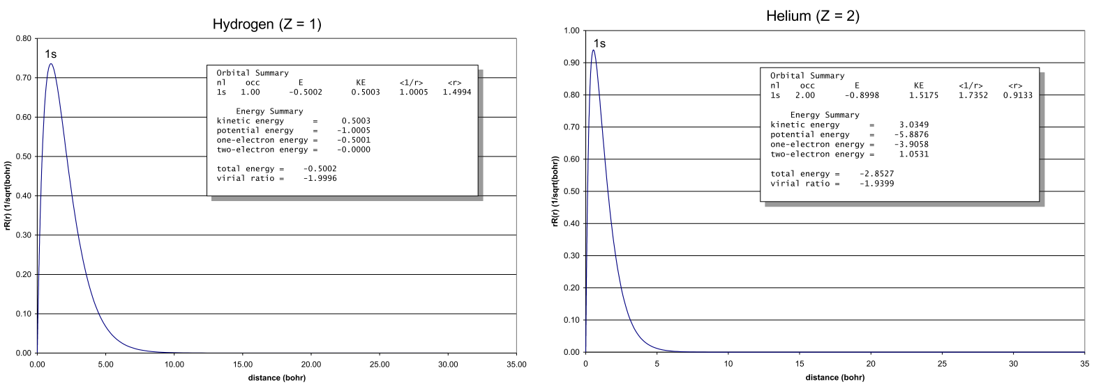
FDA results
FDA is a knock-off of Herman and Skillman's 1963 code.

Slide 4
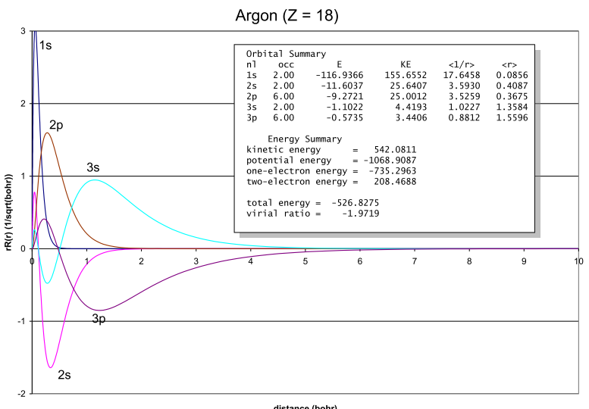
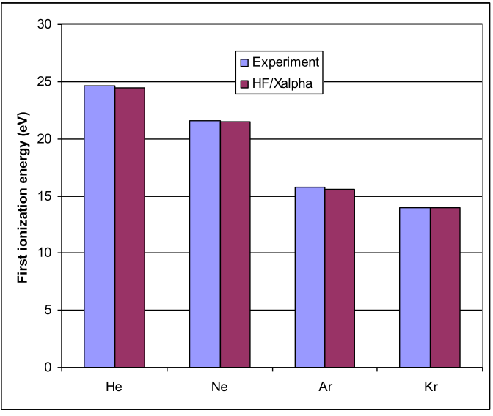
FDA results
Unit: Hartree
Koopman’s theorem
Assumes no relaxation of orbitals
Ionization Energy: the energy required to ionize the atom
M(g) → M⁺(g) + e⁻
IE₁ = E [ M⁺ (g) ] – E [ M(g) ] ≈ | Ꜫ_{HOMO} |
Electron affinity EA: the energy required to remove a bound electron from an anion to produce the neutal atom
M⁻(g) → M(g) + e⁻
EA = E [ M(g) ] – E [ M⁻(g) ] ≈ | Ꜫ_{LUMO} |

Slide 5
Correlations
Hartree-Fock doesn’t work well when making/breaking bonds, or any system with “weak” electron interactions.
The wavefunction can be written as one Slater determinant.
Each electron interacts with an average charge distribution due to the other electrons.
Electron Correlation: Difference between energy calculated with exact wave-function and energy from using Hartree-Fock wavefunction.
E_{corr} = E_{exact} - E_{HF}
It accounts for the neglect of instantaneous electron-electron interactions of Hartree-Fock method.
we get correlation energy by adding additional Slater determinants to our expansion of wavefunction.
Discuss this later….

